Slide 1

Basic concepts in coding of analyses of bio-medical data
Elizaveta Razvarina
elizavetar@campus.technion.ac.il

Slide 2
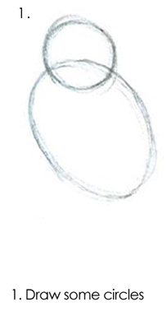
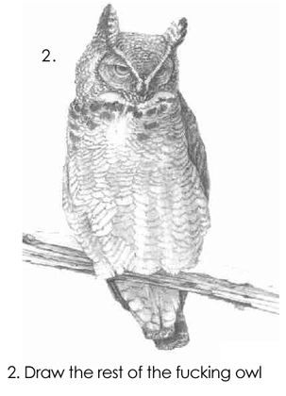
Our path to advanced analysis looks like tutorial:

Slide 3

Main home messages for today: 12/04/2026
MATRIX LABORATORY
Variable types - it’s not just a number
Statistics analysis in Matlab - you will be as happy as

Slide 4
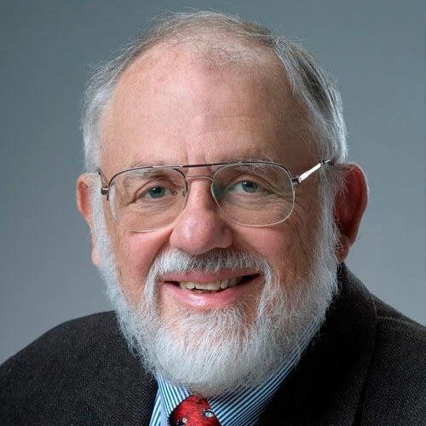
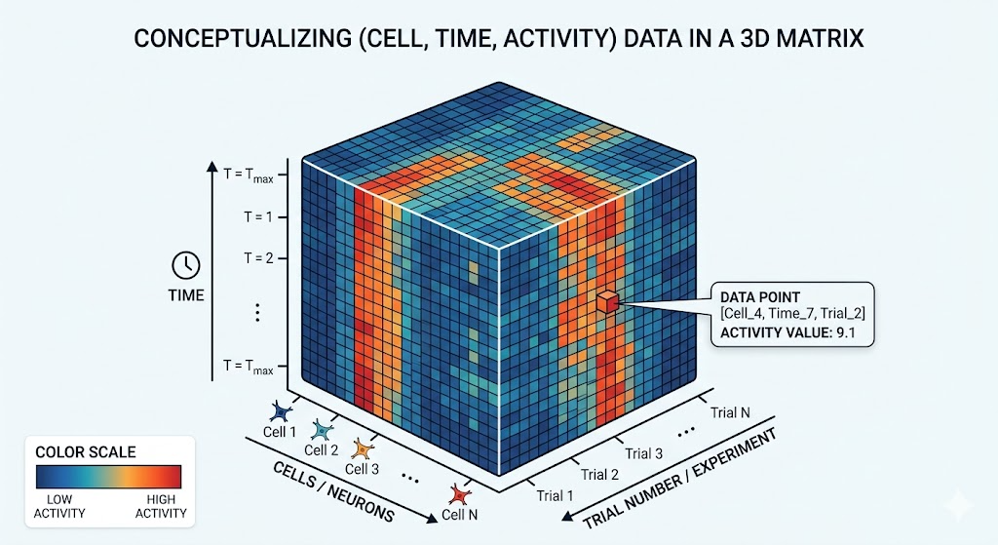
Before to install
MATLAB was originally developed in the late 1970s by Cleve Moler, a professor of mathematics who decided to provide his students easy access to libraries for numerical linear algebra, essentially making matrix computations accessible without diving into lower-level programming (good professor).
MATLAB stands for MATrix LABoratory. It was builded to work with multi-dimensional matrixes. And for biology, where we have data in 3D dimension (cell, time, activity), 4D, ... its extremly important product advantage.

Slide 5
Before to install
1. The "No-Loop" advantage for multidimensional data Biological data (Imaging, EEG, Omics) = Massive Multidimensional Matrices.
Vectorization: Processes entire datasets instantly using linear algebra, bypassing slow, nested for loops.
2. The electrophysiology gold standard
Native environment for trusted, peer-reviewed toolboxes: EEGLAB, FieldTrip, SPM. Standardized pipelines for artifact rejection, spectral analysis, and brain mapping.
3. SimBiology: modeling dynamic systems
Visual Pathway Builder: Drag-and-drop interface to build complex biological networks and pharmacological models (PK/PD). Math-Free Coding: Automatically translates biological diagrams into complex differential equations (ODEs). Simulation: Test drug dosing and simulate outcomes across thousands of "virtual patients."

Slide 6
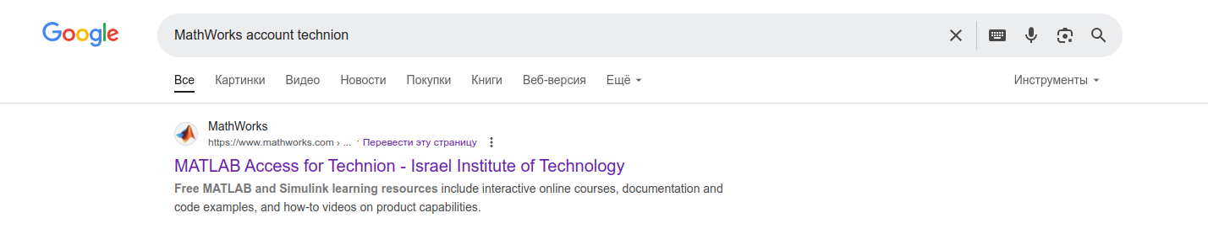
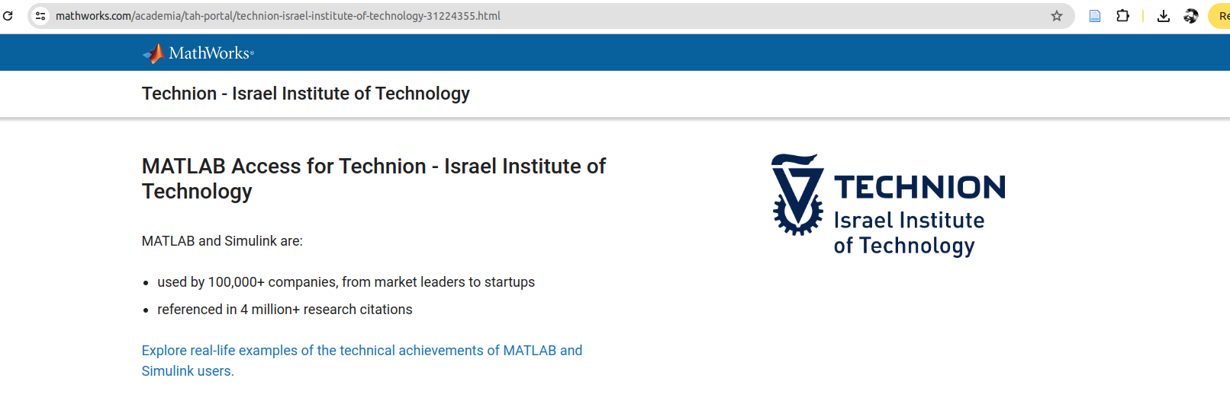
Installation

Slide 7
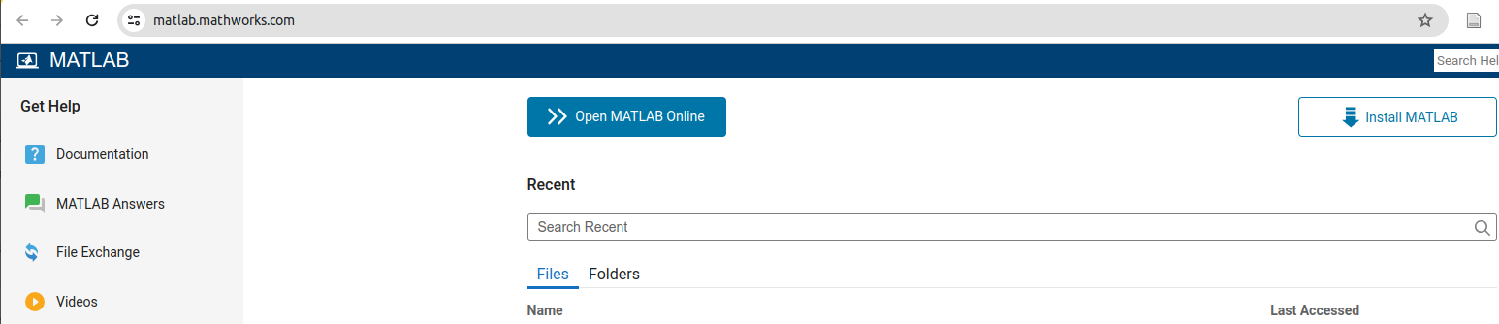
Installation or web-based version

Slide 8
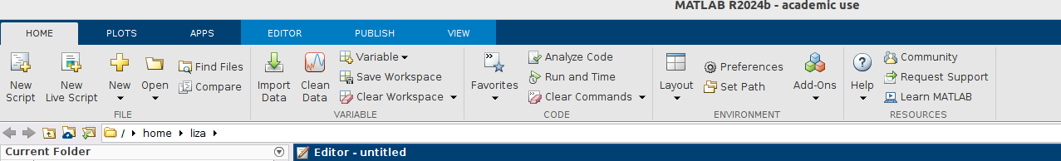
Let’s look

Slide 9





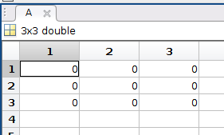

Matrix-based MATLAB language
Core Data Structure: The basic data structure in MATLAB is a matrix (or an array). Even a single number is treated as a 1×1 matrix.
Natural Syntax for Mathematical Operations: Operations like addition, multiplication, and division are performed on whole arrays at once without needing explicit loops. For example, adding two matrices will automatically perform element-wise addition.
Built-in Functions: MATLAB provides a wide range of functions that operate on matrices—such as solving linear systems, performing eigenvalue decomposition, or executing matrix factorizations—all optimized for matrix computations.

Slide 10
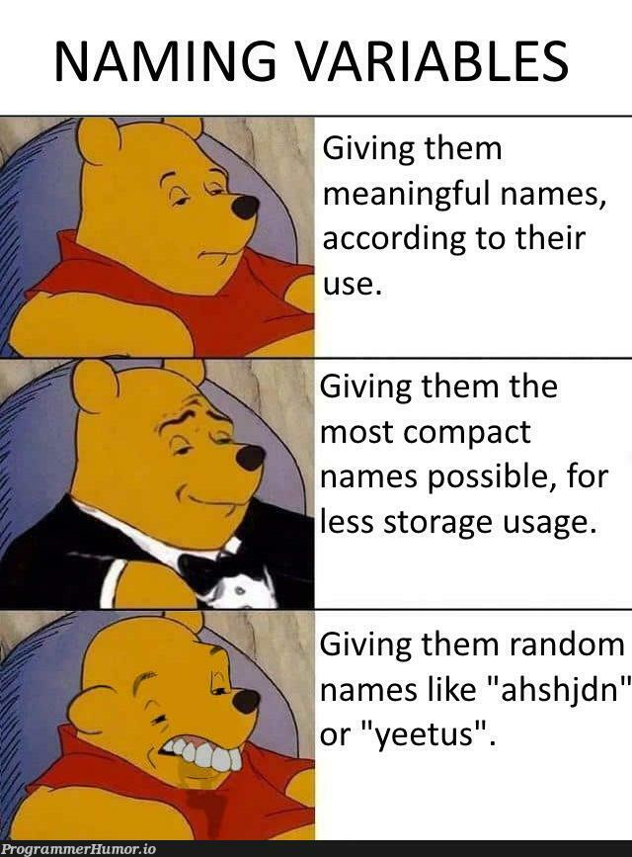

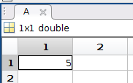
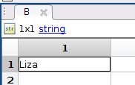
Variables
Naming Conventions:
Variable names must start with a letter.
They can contain letters, digits, and underscores.
MATLAB is case-sensitive (Variable is different from variable).
Workspace:
Variables are stored in the MATLAB workspace, which you can view using the whos or who commands.

Slide 11
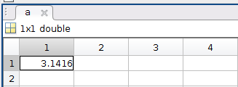


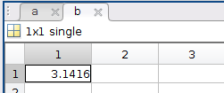
Variable types: numbers
Double (64 bits):
The default numeric type in MATLAB. Every number you enter (unless specified otherwise) is stored as a double-precision floating-point number. double precision is incredibly accurate for biology, but you should never trust a number past the 15th decimal place!
Single (32 bits):
Single-precision floating-point numbers, which use less memory but offer lower precision.

Slide 12
Variable types: Integers
MATLAB offers several integer types that allow you to work with whole numbers while controlling the amount of memory used and specifying whether the numbers can be negative or only nonnegative.
Signed Integer Types
int8:
Size: 8 bits (1 byte)
Range: -128 to 127
Usage: Use when you need to store small negative or positive integers.
int16:
Size: 16 bits (2 bytes)
Range: -32,768 to 32,767
Usage: Suitable for moderately sized integers, balancing memory and range.
int32:
Size: 32 bits (4 bytes)
Range: -2,147,483,648 to 2,147,483,647
Usage: This is often the default for many applications requiring integers, offering a large range.
int64:
Size: 64 bits (8 bytes)
Range: Approximately -9.22e18 to 9.22e18
Usage: Use for very large integer values when memory is not a primary concern.

Slide 13
Variable types: Integers
Unsigned Integer Types
Unsigned integers can only represent nonnegative values, but they double the positive range compared to their signed counterparts because no bit is reserved for the sign.
uint8:
Size: 8 bits
Range: 0 to 255
Usage: Useful for storing small nonnegative integers, such as pixel values in images.
uint16:
Size: 16 bits
Range: 0 to 65,535
Usage: Often used in applications where negative values aren’t needed and a larger range is desired.
uint32:
Size: 32 bits
Range: 0 to 4,294,967,295
Usage: Commonly used for large counting numbers or indices when only nonnegative values are needed.
uint64:
Size: 64 bits
Range: 0 to 18,446,744,073,709,551,615
Usage: Use when you need to store very large nonnegative numbers.

Slide 14

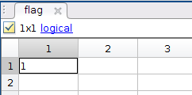
Variable types: logical
Logical:
Represents boolean values (true or false). Useful in conditionals and for indexing.

Slide 15

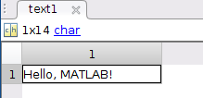
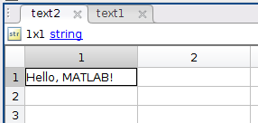

Variable types: character arrays and strings
Character Arrays:
Traditional way to store text. A sequence of characters enclosed in single quotes. You can index by character
String Arrays:
Introduced in recent versions, string arrays are created using double quotes, you have only 1 element string. You can’t index by character

Slide 16
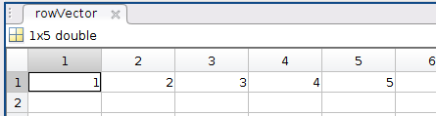

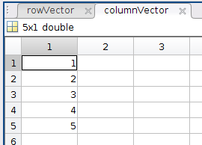

Variable types: Vectors
A vector is a one-dimensional array. It can be either a row vector or a column vector. Simplest form of an array, used for sequences and lists of numbers.

Slide 17

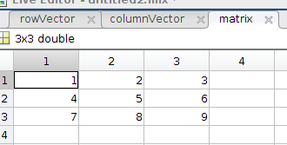
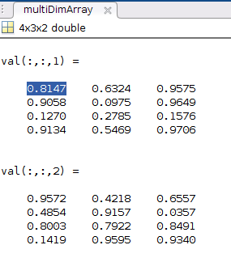

Variable types: Arrays
Suitable for mathematical operations like matrix multiplication, element-wise operations, and more.

Slide 18


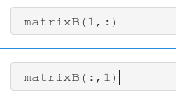
Operations with Vectors and Arrays
Element-wise Operations:
Use the dot (.) operator before an operator for element-by-element computation.
Extracting Elements:
Slicing Matrixes:

Slide 19


Variable types: cell arrays
Cell arrays are containers that can store different types and sizes of data in each element.

Slide 20



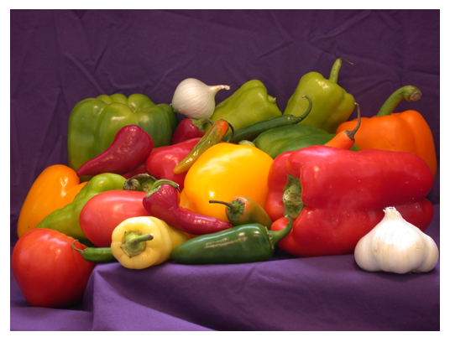
Variable types: NB! look on the variable type)
Before beginning any processing, it's essential to identify the types of variables that will be involved

Slide 21
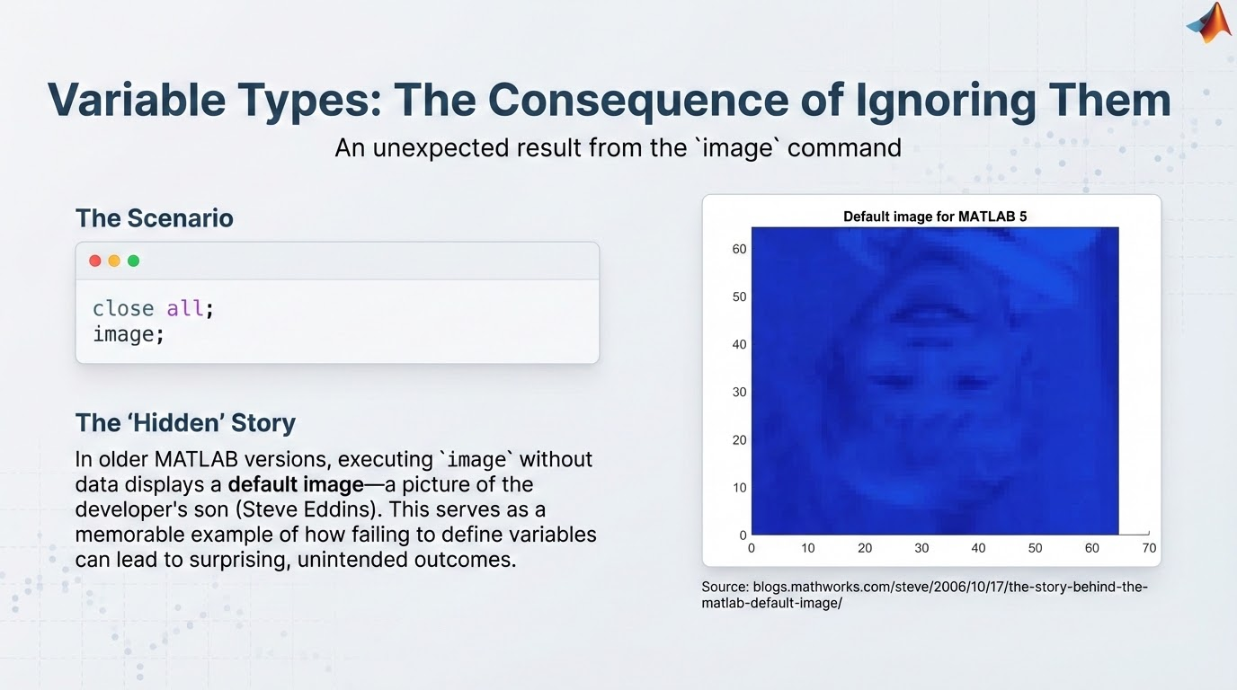

Slide 22
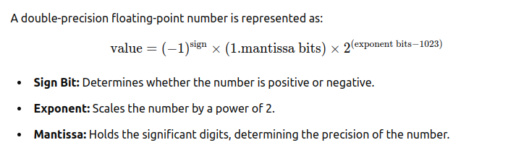
Just for fun
When we say MATLAB handles numbers in double-precision, we mean that each number is stored using 64 bits (or binary digits) according to the IEEE 754 standard. This representation is divided into three parts:
Sign Bit: Determines if the number is positive or negative.
Exponent: A group of bits that scales the number (essentially shifting the decimal point). In double-precision format, the exponent is stored using 11 bits. These bits represent the power of 2 by which the number is scaled.
Mantissa (or Significand): The remaining bits that hold the actual digits of the number—the “meat” of the value. This part tells you the precision of the number, i.e., how many significant digits it contains.
in 5 bits of mantisa part (from 47 to 51) Steve Edins hide his eldest son) from 42 to 46 - a dog

Slide 23
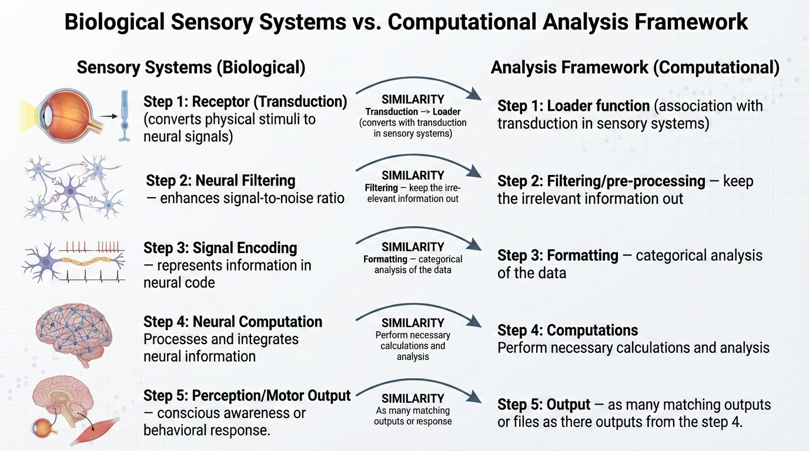
High performance analysis framework

Slide 24


Additional steps
Step 0: clear the workspace and define constants (for example, frames per second)
Step 6: Readme file

Slide 25
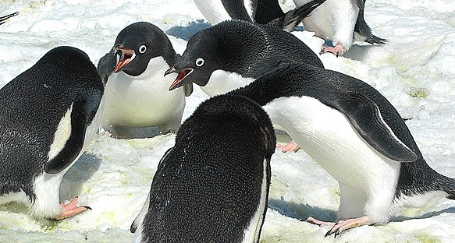
Statistical Methods
When we are talking about statistical methods for describing data, we are talking about using a collected sample of an overall population to make descriptions of the population as a whole.
*If your data set is very small or you have a lot of missing values, you may not have enough data to make meaningful observations. And in that case, you'll probably need to collect more data!
We will use palmerpenguins dataset from Matlab Biosciences Data Module (*you can look by yourself).
Adelie penguins having a group meeting
https://github.com/mwaskom/seaborn-data/blob/master/penguins.csv
https://allisonhorst.github.io/palmerpenguins/

Slide 26
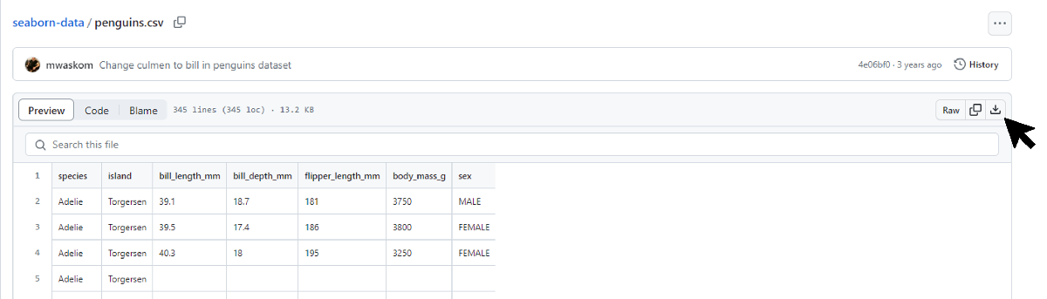
Load data
Load database from Github repository into the Matlab directory or add the path of the folder with file
https://github.com/mwaskom/seaborn-data/blob/master/penguins.csv

Slide 27
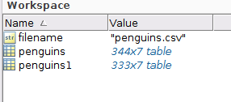


Load and clean data

Slide 28
Fast description stats of the variabels

Slide 29
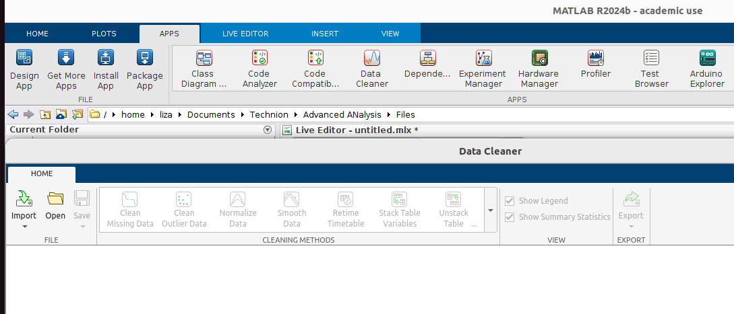
Use an App to do the cleaning

Slide 30


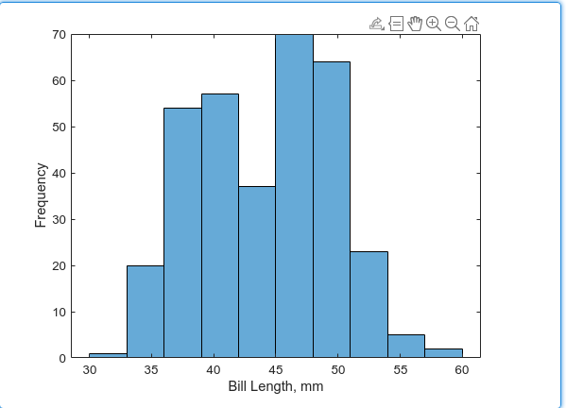
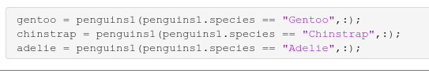
Visualize the distribution of your data

Slide 31
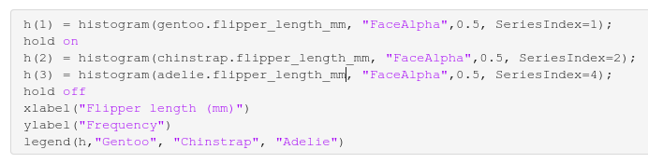
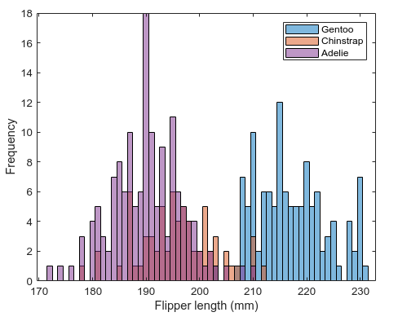
Visualize the data
The SeriesIndex property automatically assigns colors, line styles, and markers to different data series plotted on the same axes based on MATLAB's default or current color order and style order settings.

Slide 32

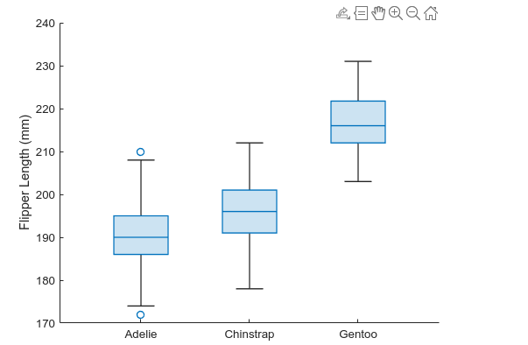
I prefer boxplots

Slide 33

Hypothesis testing
Hypothesis 1: Male penguins have significantly higher body mass than female penguins.
Initial hypothesis = alternate hypothesis, which in this case is that:
males have a significantly higher body mass than females.
Null hypothesis = no effect or relationship between the variables you are looking at. In this case, it would say that:
there is no difference in the weights of male and female penguins.
If we want to say the male and female weights are significantly different, we have to prove the null hypothesis is wrong (or 'reject' it).

Slide 34

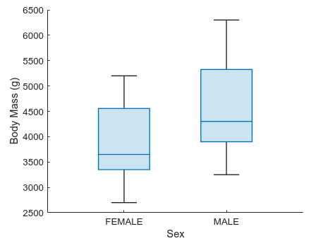
Visualization
t-test calculates how likely it is that the two distributions you are comparing are from one indistinguishable distribution or population.
In our case, if the likelihood of your data being from one indistinguishable group is greater than 5%, the null hypothesis is accepted.
“Likelihood” is what?

Slide 35
Testing hypothesis
Weight differences between male and female penguins are statistically significant.
Weight of male penguins is significantly higher than for female.
Hypothesis 2: Males have significantly longer bills than females.

Slide 36
HomeWork#1, use https://github.com/mwaskom/seaborn-data/blob/master/penguins.csv
Visualization
Plot the histogram for Chinstrap body mass yourself, using Series Index 2 for color, with 0.5 transparency.
Do the same for Adelie body mass (the same figure), with Series Index 4 for color and 0.5 transparency.
Turn the plotting hold off.
Add x and y labels to your chart, as well as a relevant title.
Add a labeled legend for clarity. Descriptive statistics
Add the code for the main descriptive statistics summaries and calculate correlation between flipper length and body mass. Test Hypothesis
H1: Chinstrap penguins are significantly larger than Adelie penguins.
*Send the Name_HW1.mlx or Name_HW1.m files to elizavetar@campus.technion.ac.il before 19/04/26

